Slide 1


Early detection of colon cancer
Supervised by
Prof. Abeer El-Korany
Dr. Ibrahim Zaghloul
TA. Menna Youssef
Implemented by
IDs | Students’ names
20198062 | Amr Yehia Zakaria
20198021 | Gamal Hanafi Khalil
20198071 | Mohamed Ramadan Mohamed
20188045 | Mahmoud Khaled Helmy
20198102 | Yomna Farid Mohamed
Graduation Project
Academic Year 2022-2023
Midyear Presentation

Slide 2
01
Project idea
02
Problem significance
CONTENT
03
Project Specifications
04
Time plan
05
References

Slide 3
The goal of our project is early detection of colon cancer by taking an image and classify if it is a cancer or not then determine the location of the cancer from it by using the segmentation technique So, we will be able to help doctors and save their time and it will speed the rate of discovering the disease.
The earlier we discover cancer, the higher the chances of survival.
Our domain of interest is using medical image classification and segmentation field to detect colon cancer earlier.
Project idea
3

Slide 4
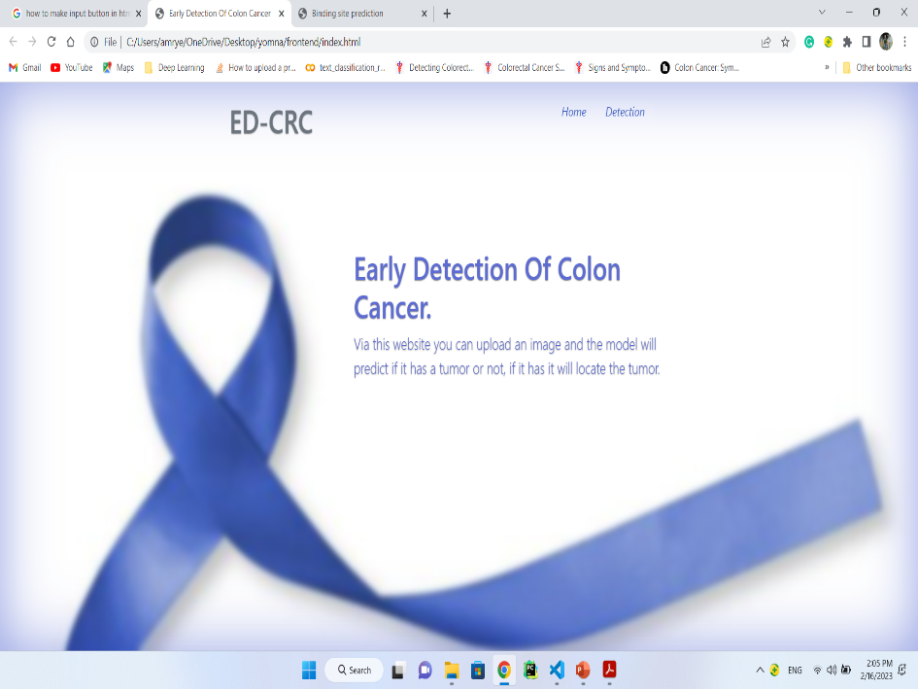
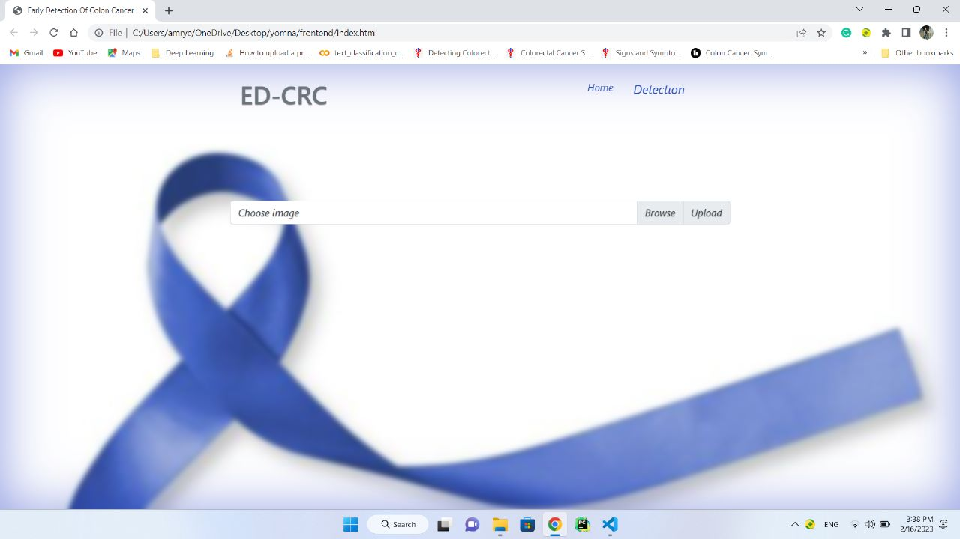
Our website
4

Slide 5
Problem significance
1
2
The problem we are going to solve.
Why?
4
3
How?
Previous solutions.

Slide 6
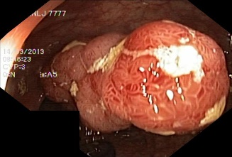
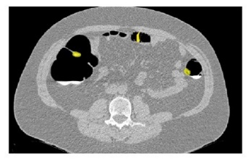
The problem we are going to solve
Colorectal polyps and cancer can be found early by screening.
These screening tests can be divided into 2 main groups:
Stool-based tests
Visual (structural) exams
Colonoscopy CT-Colonography
Colonoscopy is the gold standard for the detection and assessment of these polyps with subsequent biopsy and removal of the polyps.
6

Slide 7
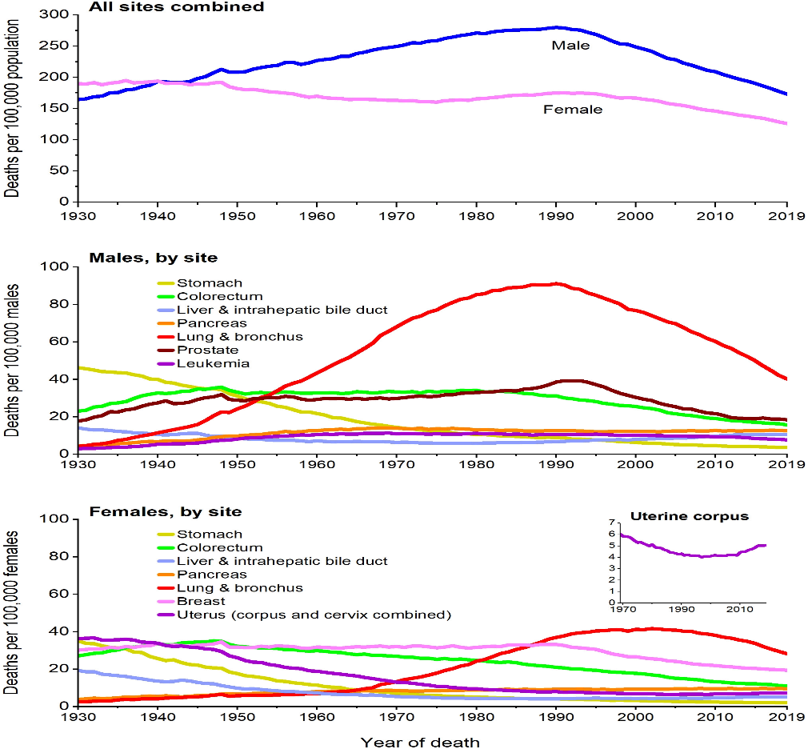
Cancer is a leading cause of death worldwide, accounting for nearly 10 million deaths in 2020, or nearly one in six deaths, Cancer is the second cause of death worldwide, a total of 1.9 million new cancer cases and 609,360 deaths from cancer are expected to occur in the US in 2022, which is about 1,670 deaths a day. By American cancer society
Why Cancer?
7

Slide 8
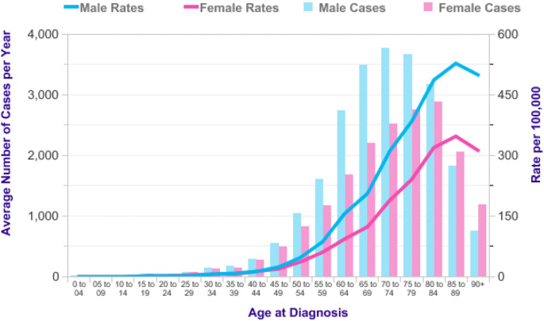
Colorectal cancer is the second most common cancer type among women and third most common among men.
Why Colon Cancer?
By BMC Cancer
8

Slide 9
Why early detection?
The good news is that deaths from this disease have declined compared with a decade ago, and early detection is apparently one reason.
If a doctor catches the cancer while it's still confined to the outer lining of the colon or rectum, you can probably look forward to a full recovery.
When colorectal cancer is found at an early stage before it has spread, the 5-year relative survival rate is about 90%, When cancer has spread outside the colon or rectum, survival rates are lower.
This news based on American cancer society.
9

Slide 10
Previous solutions
Stage 1 – Classification
Classification of Anomalies in Gastrointestinal Tract Using Deep Learning 2022.
used Resnet and accuracy 85.69%.
KVASIR: A Multi-Class Image Dataset for Computer Aided Gastrointestinal Disease Detection 2017.
used CNN with accuracy 71% and Inception v3 with accuracy 80%.
10

Slide 11
Previous solutions
Stage 2 – Segmentation
A Nested U-Net Architecture for Medical Image Segmentation 2018
An Advanced Architecture for Medical Image Segmentation
2019
used Res U-net++ and mean dice 81.33%
used U-net++ and mean dice 82.10%
A Segmented Polyp Dataset
2020
A Comprehensive Study on Colorectal Polyp Segmentation
2021
used Res U-net and mean dice 78.77%
used Res U-net++ and mean dice 85.08%
11

Slide 12
Limitation of previous work
Limitations
They didn’t apply data augmentation, fine tuning that can improve the results.
12

Slide 13
How to solve the problem?
The problem is divided into two stages:
Classification
Medical image classification is one of the most important problems in the image recognition area.
It aims to classify medical images into different categories to help doctors in disease diagnosis or further research.
Overall, medical image classification can be divided into two steps:
The first step is extracting effective features from the image.
The second step is using the features to build models that classify the image dataset.
13

Slide 14
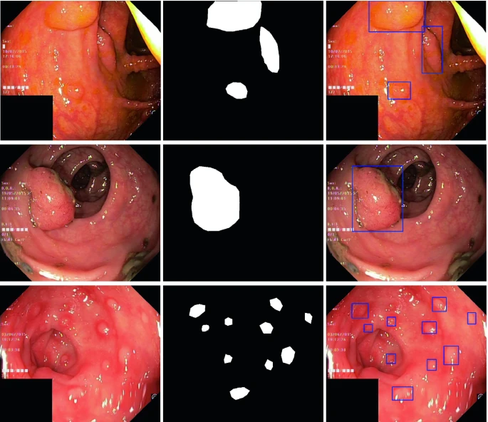
Segmentation
Image segmentation is the technique of dividing images into meaningful Regions of Interests (ROIs) that are simple to analyze and interpret.
The predicted output of the process is an image contains the ROIs only or we assign a bounding box on the ROIs on the image.
The goal of image segmentation is to assign a label to each pixel of the image so the pixels with the same label share specific characteristics.
As segmentation reduce the risk factors of the colon cancer, it helps doctors to detect the location of the cancer, so the survival of the patient will be faster.
14

Slide 15




02
04
Project Specifications
01
03
Stakeholders
System
architecture
Functional
Requirements
Non-functional
Requirements
15

Slide 16

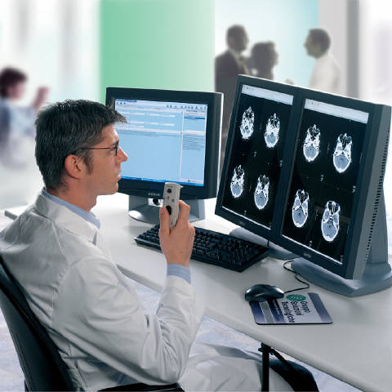
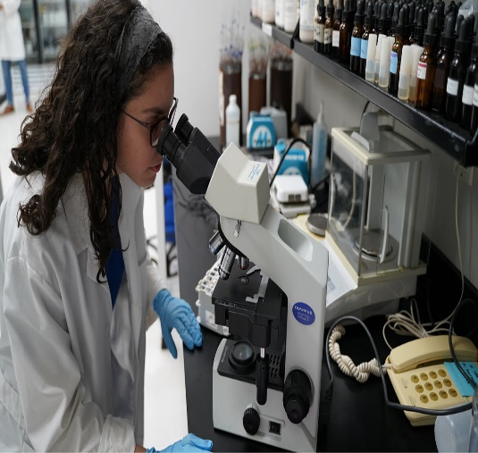
Stakeholders: Medical Professionals
Oncologists
Radiologists
Pathologists
16

Slide 17
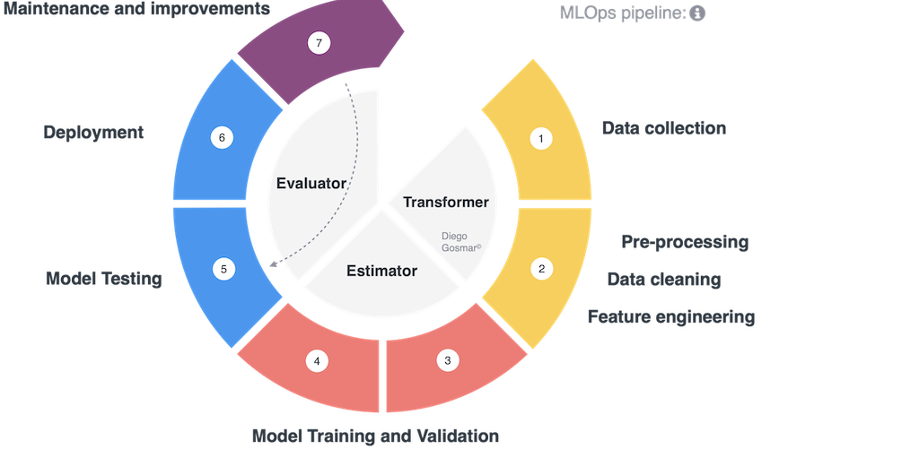
System architecture

Slide 18
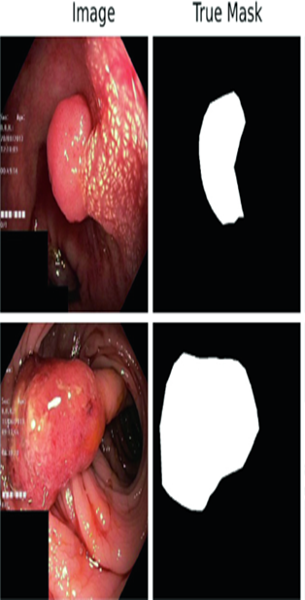
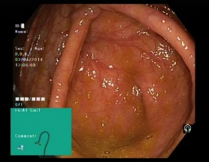
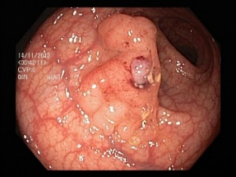
Data Collection
We will use the Kvasir dataset, which is the first multi-class dataset for disease detection and classification.
These polyp images along with their corresponding segmentation masks and bounding boxes.
The ROIs are generated from manual annotations verified by an experienced doctors.
Four datasets of Kvasir:
Kvasir for classification
Kvasir-seg
Kvasir-sessile
Hyper-Kvasir
Kvasir-seg
normal
polyps
18

Slide 19
Preprocessing and feature engineering
Data Augmentation
Feature extraction
Cleaning
Normalization
19

Slide 20
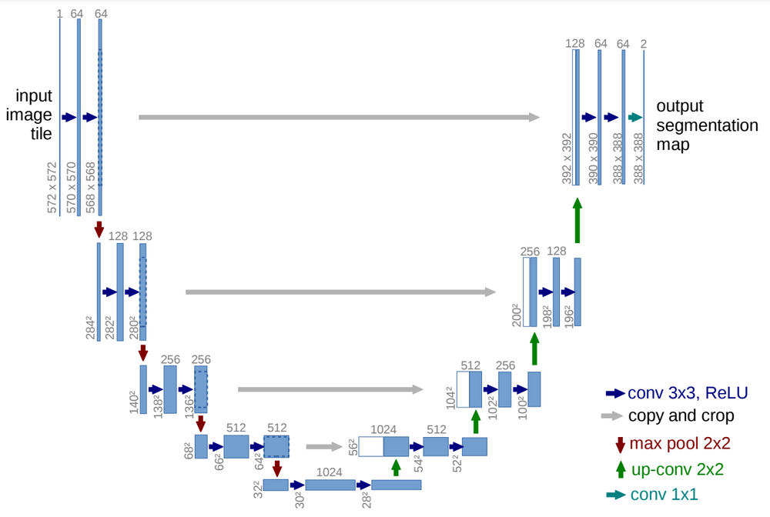
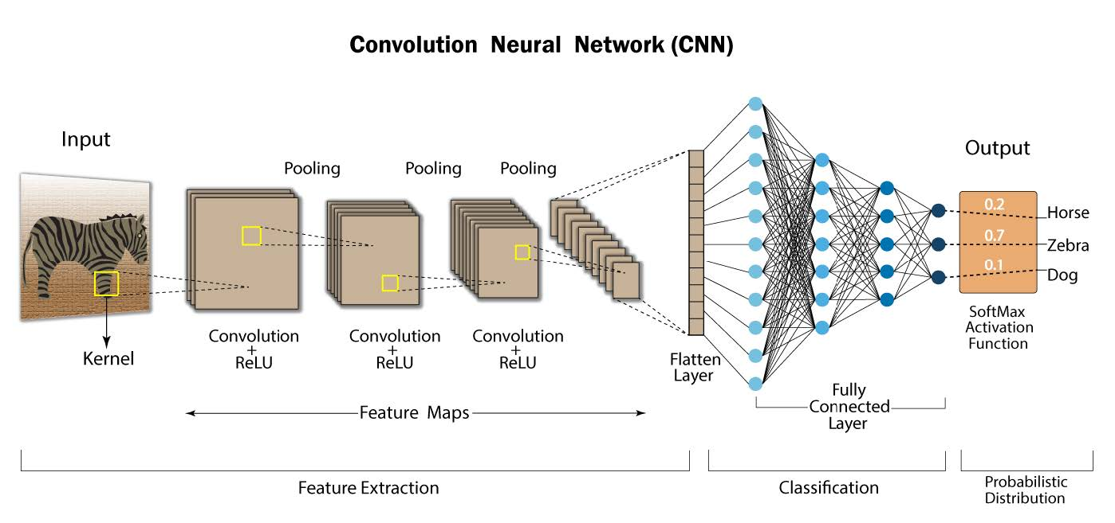
Modeling and training
Split data into training, validation and testing.
Build classification models as CNN.
Build Segmentation models as U-net.
U-net
CNN
20

Slide 21


Evaluation
The trained model is evaluated based on its performance on given test sets as mean dice , mean IOU.
Deployment
The model is deployed to systems that make use of it such as web applications, mobile applications and so on.
21

Slide 22
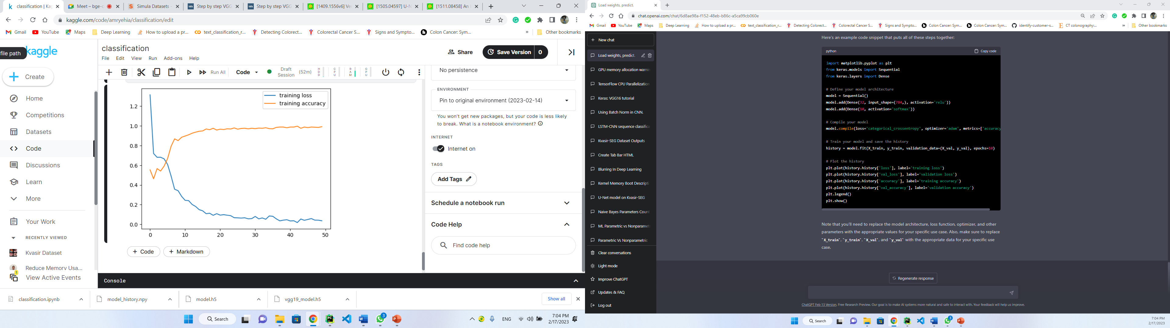
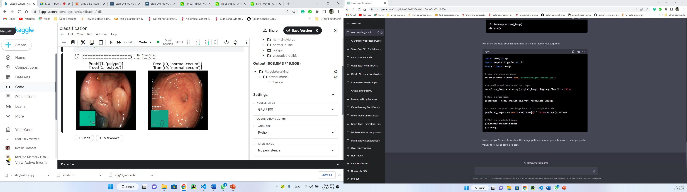
We started classification stage and had got a good accuracy of 89% by training the data with VGG16.

Slide 23
Functional Requirements
Deal how the system behave
A platform to input these images, such as web-based interface.
Upload image as input.
Doctor will add patient’s history.
Process the given image.
Detect the location of tumor and Segment it.
Website registration
The doctor can show patient’s history and check the results.
23

Slide 24
Non-functional Requirements
Refer to system qualities
Usability: our system can be easy to use.
Efficiency: The system will be able to process images quickly and accurately
Scalability: Our project is divided to modules that have ability to extend.
24

Slide 25
Time plan
25

Slide 26
References
Boesch, G. (2023, January 1). A complete guide to Image Classification in 2023. viso.ai. Retrieved February 12, 2023,Jha, D. et al. (2020). Kvasir-SEG: A Segmented Polyp Dataset. In: , et al. MultiMedia Modeling. MMM 2020. Lecture Notes in Computer Science(), vol 11962. Springer, Cham.
Common cancer sites - cancer stat facts. SEER. (n.d.). Retrieved February 17, 2023.
Dheir.M.S&Abu naser.S.S(2022)International Journal of Academic Engineering Research,"Classification of Anomalies in Gastrointestinal Tract Using Deep Learning”(6)3,:15-28.
Jha, D., Smedsrud, P. H., Johansen, D., de Lange, T., Johansen, H. D., Halvorsen, P., & Riegler, M. A. (2021). A Comprehensive Study on Colorectal Polyp Segmentation With ResUNet++, Conditional Random Field and Test-Time Augmentation. IEEE journal of biomedical and health informatics, 25(6), 2029–2040.
Jha, D., Smedsrud, P. H., Riegler, M. A., Johansen, D., De Lange, T., Halvorsen, P., & Johansen, H. D. (2019, December). Resunet++: An advanced architecture for medical image segmentation. In 2019 IEEE International Symposium on Multimedia (ISM) (pp. 225-2255). IEEE.
Konstantin Pogorelov, Kristin Ranheim Randel, Carsten Griwodz, Sigrun Losada Eskeland, Thomas de Lange, Dag Johansen, Concetto Spampinato, Duc-Tien Dang-Nguyen, Mathias Lux, Peter Thelin Schmidt, Michael Riegler, and Pal Halvorsen. 2017. KVASIR: A Multi-Class Image Dataset for Computer Aided Gastrointestinal Disease.
Pogorelov, Konstantin & Randel, Kristin & Griwodz, Carsten & de Lange, Thomas & Eskeland, Sigrun & Johansen, Dag & Spampinato, Concetto & Dang Nguyen, Duc Tien & Lux, Mathias & Schmidt, Peter & Riegler, Michael & Halvorsen, Pål. (2017). KVASIR: A Multi-Class Image Dataset for Computer Aided Gastrointestinal Disease Detection. 10.1145/3083187.3083212
ZhiFei Lai, HuiFang Deng, "Medical Image Classification Based on Deep Features Extracted by Deep Model and Statistic Feature Fusion with Multilayer Perceptron‬", Computational Intelligence and Neuroscience, vol. 2018, Article ID 2061516, 13 pages, 2018.
Zhou, Z., Rahman Siddiquee, M.M., Tajbakhsh, N., Liang, J. (2018). UNet++: A Nested U-Net Architecture for Medical Image Segmentation. In: , et al. Deep Learning in Medical Image Analysis and Multimodal Learning for Clinical Decision Support. DLMIA ML-CDS 2018 2018. Lecture Notes in Computer Science(), vol 11045. Springer, Cham.
26

Slide 27
THANK YOU
^_^

